Slide 1
Robot Circuit

Slide 2
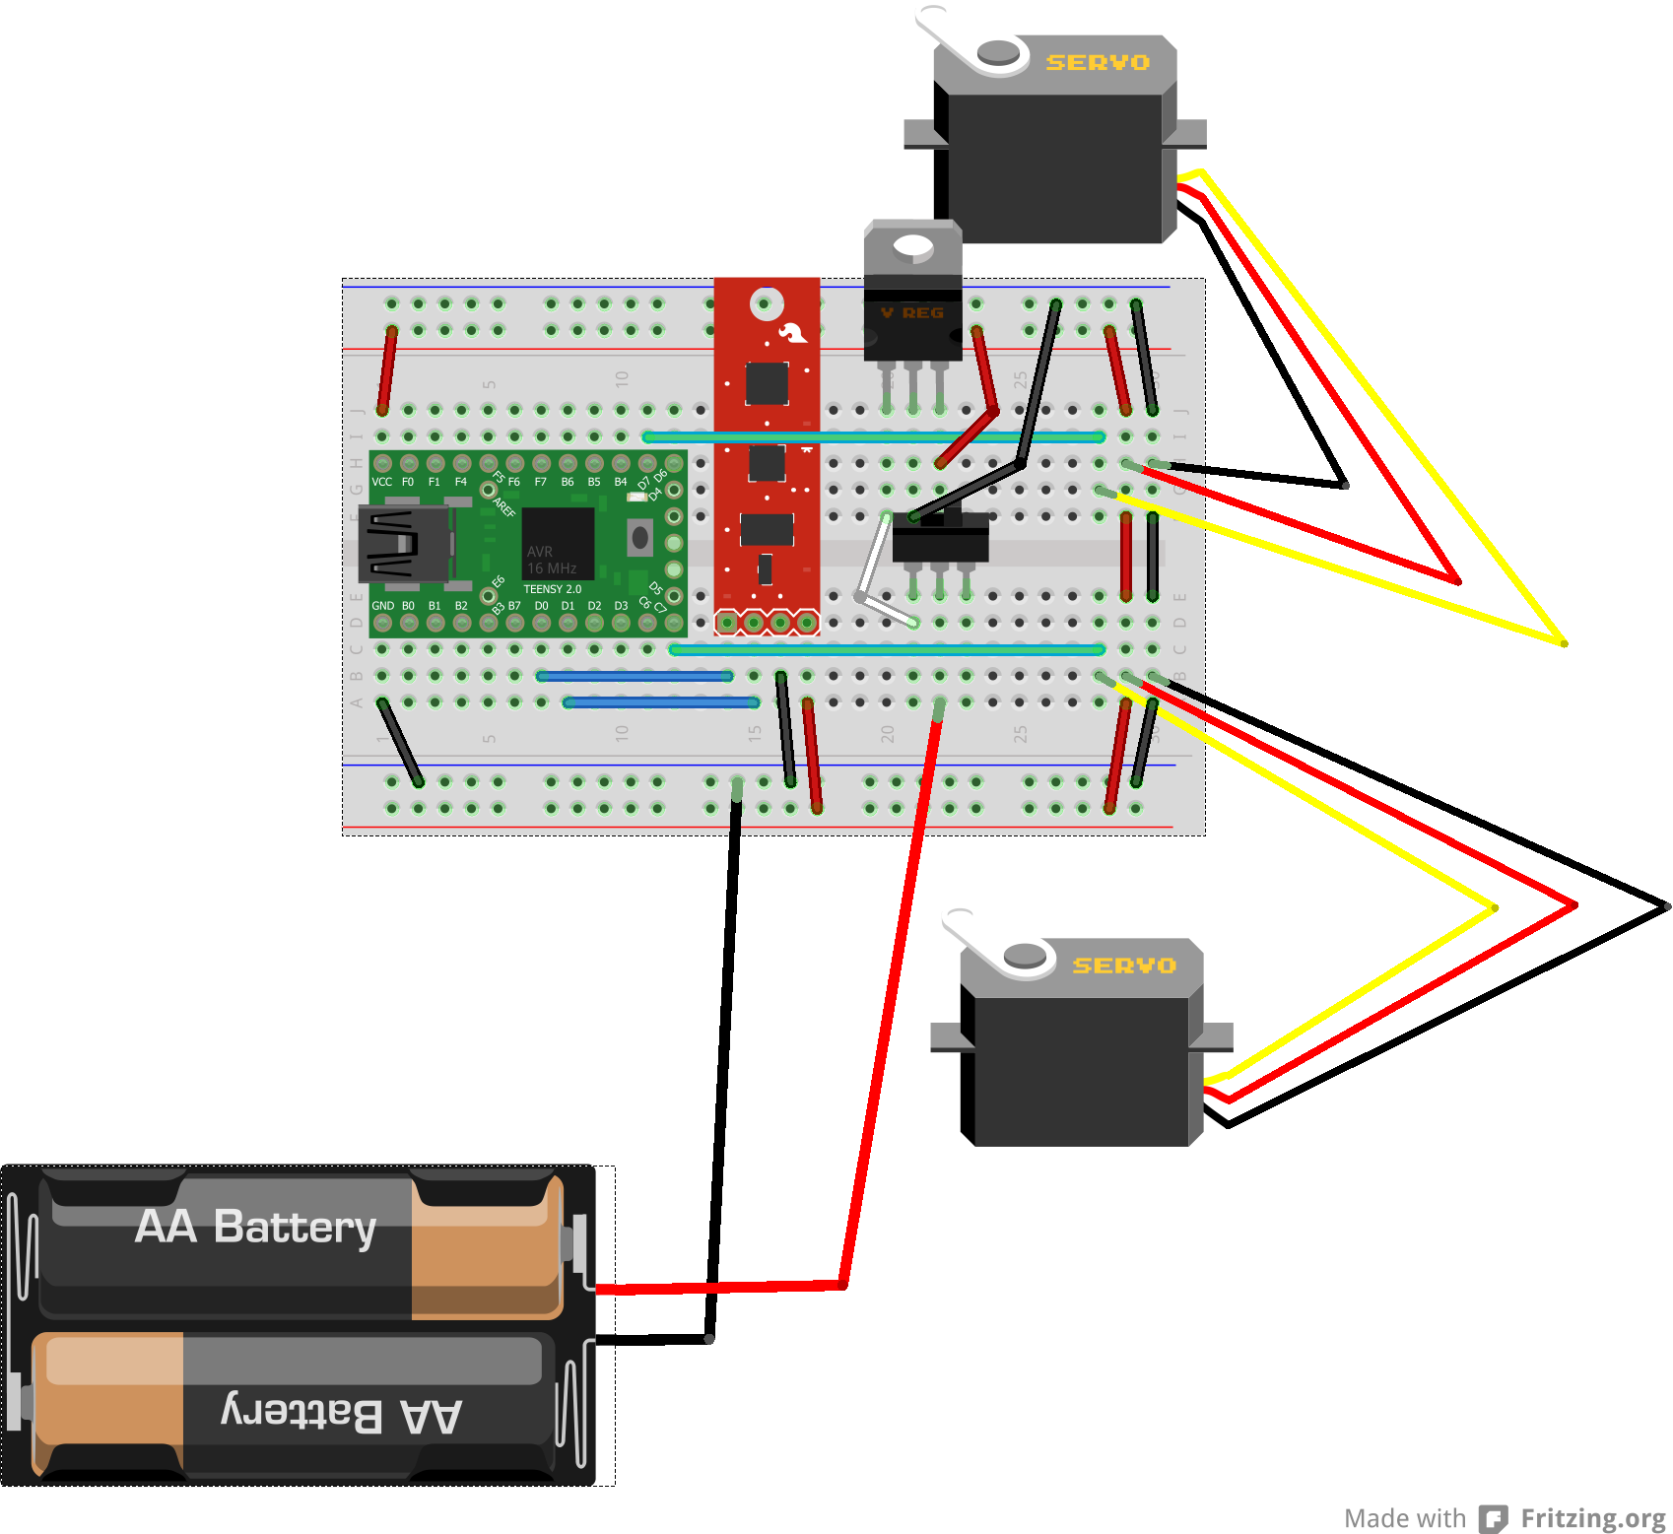
Wiring

Slide 3
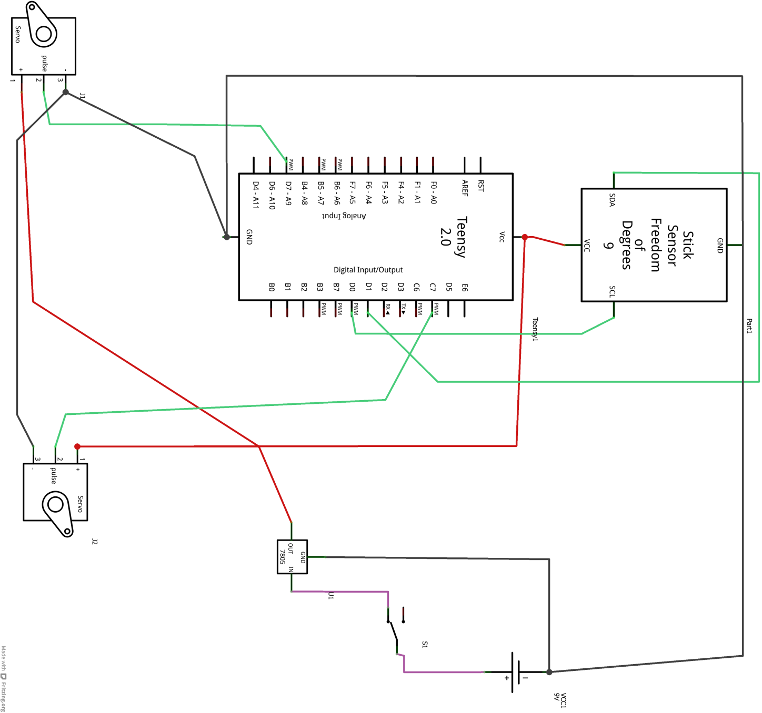
Schematic

